Slide 1




Data Analysis with Python
Module 06
If you try to install pandas, sometimes it feels like pandas is more than a library;
it’s like inviting a whole zoo to your system! 🐼📊

Slide 2


Class Objectives
1
Practice using Pandas to load, clean, and manipulate data for analysis.
2
Apply descriptive statistics and data exploration techniques to summarize and understand the dataset.
3
Use Seaborn to create visualizations that uncover trends and patterns in the data.
4
Develop skills in handling missing data and preparing datasets for further analysis.

Slide 3

The Data Analyst's Toolbox
Mastering Python and Beyond

Slide 4






The Data Analyst's Toolbox

Slide 5
Why Use Pandas for Data Analysis?
Industry Standard
Key Features
DataFrames for structured data: rows and columns, flexible data types.
Efficient handling of large datasets: fast operations even with millions of rows.
Handles missing data: easy methods for cleaning and filling missing values.
Why Pandas Over Other Tools?
Excel: Handles larger datasets and automates repetitive tasks.
SQL: More flexible data manipulation directly in memory.
NumPy: More advanced operations on heterogeneous data types.

Slide 6

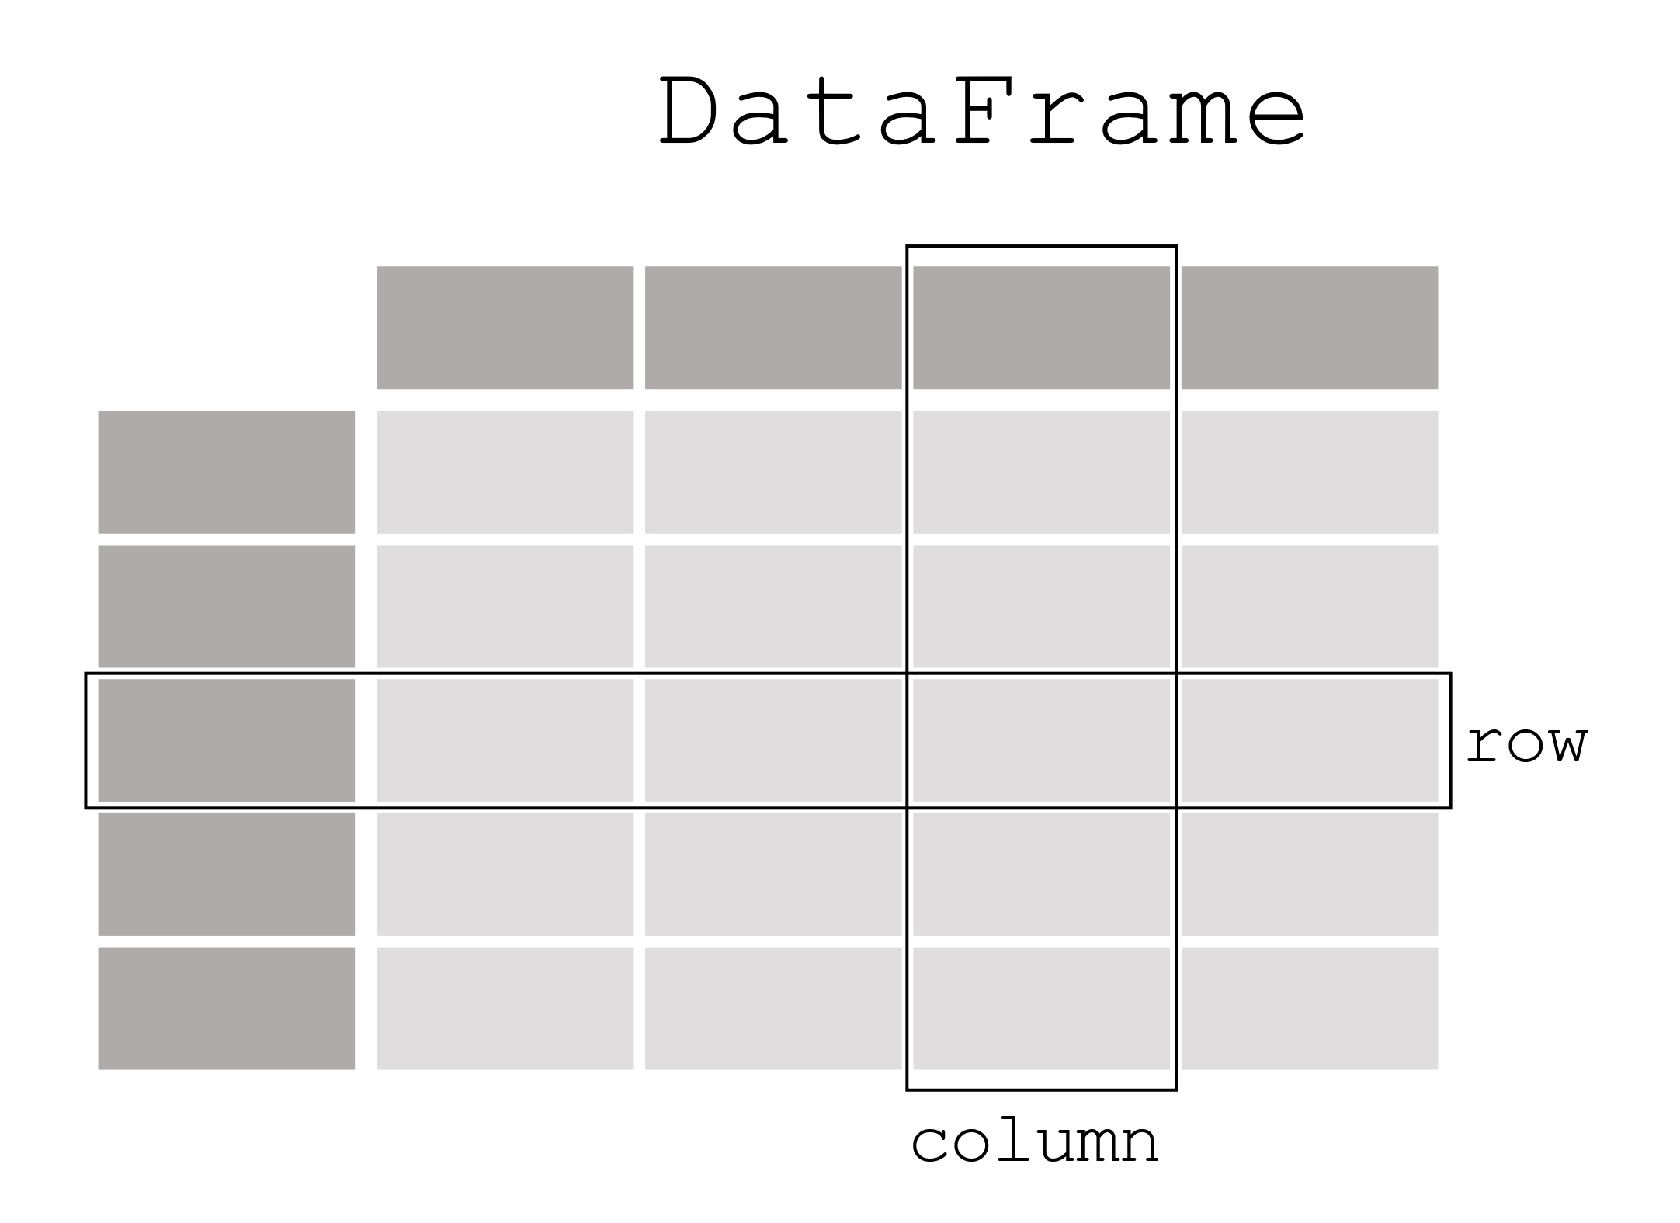
Overview of Pandas Data Structures
Data Series: A one-dimensional array, like a list, but with labels.
Data Frames: A two-dimensional table (like a spreadsheet), consisting of rows and columns, where each column can be of different types.

Slide 7
Handling Missing Data
Why it matters: Missing data is common in real-world datasets. If not handled properly, it can lead to biased or inaccurate analysis.
Impact on analysis: Missing values can affect statistical calculations, model accuracy, and the reliability of insights.
Goal: Ensure data completeness for robust and valid analysis.

Slide 8
Why Data Visualization is Important?
Insightful storytelling: Data visualization helps turn raw data into actionable insights that are easy to understand and communicate.
Patterns and trends: Visualizations reveal trends, outliers, and patterns in data that might be hard to detect in tables or raw numbers.
Effective communication: Graphs and charts are essential for presenting findings to stakeholders, making data-driven decisions more accessible and impactful.

Slide 9
Seaborn: A Powerful Visualization Library
Built on Matplotlib: Seaborn is built on top of Matplotlib, providing a high-level interface to create beautiful, informative visualizations with less code.
Advanced features: Includes statistical visualizations like regression plots, heatmaps, and categorical plots, which are particularly useful for data analysis.
Customization: Seaborn comes with aesthetic default styles, but it also allows customization for complex visualization needs.

Slide 10

Guided Demo
EA FIFA 22
Players Stats

Slide 11

EA FIFA 22
EA FIFA 22 is the 2022 installment in EA Sports' popular football (soccer) video game franchise, featuring a wide range of professional players and teams from around the world.
The game uses real-world player statistics and ratings to simulate football matches, allowing players to manage teams, compete in tournaments, or play with friends.

Slide 12

Why This Data?
The dataset we’ll explore is based on the in-game attributes of football players, including performance metrics like speed, shooting, dribbling, and passing.
Analyzing this dataset can provide insights into player strengths, potential transfers, and team-building strategies.

Slide 13
Challenge
The Airbnb NYC Adventure

Slide 14
The Airbnb NYC Adventure
In this activity, you will apply the skills you’ve learned to analyze Airbnb listings in New York City.
Data Exploration
Load the dataset into a Pandas DataFrame.
Identify missing values in the dataset.
Data Cleaning
Drop rows with missing values in critical columns like price and reviews_per_month.
Remove listings where the price is greater than 1000 to avoid outliers.
Analyze and Answer Key Questions Answer the following questions:
What is the average price of listings in each neighborhood group?
What are the top 5 neighborhoods with the most listings?
What is the relationship between the number of reviews per month and price?
What is the distribution of room types?
Data Visualization Create visualizations for the following:
A bar plot showing the average price by neighborhood group.
A bar plot showing the top 5 neighborhoods with the most listings.
A count plot showing the distribution of room types.
A scatterplot showing the relationship between reviews per month and price.
Get this challenge’s files from Module 05 Live Lesson Challenge in Google Classroom

Slide 15


Debrief
Let’s Review
The Airbnb NYC Adventure

Slide 16
Questions?

